Slide 1
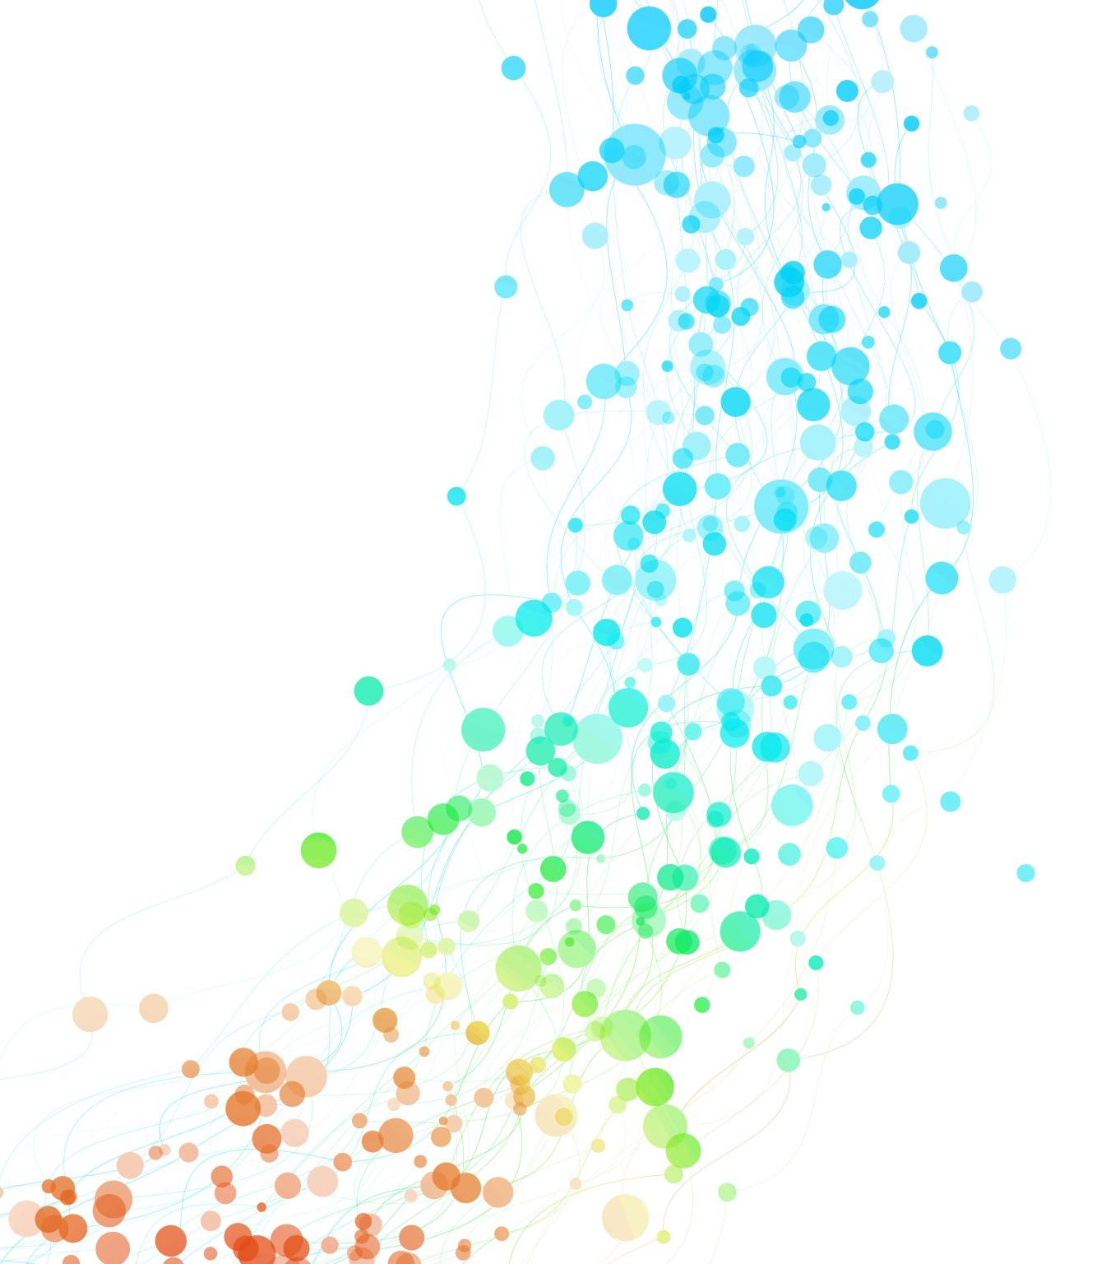
Introduction to SQL

Slide 2
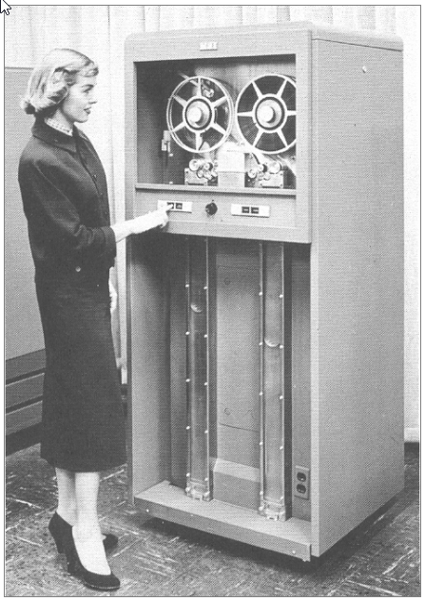
History of Databases
Magnetic tape technology had been used for audio recording and playback since World War II, and it was adapted for computer use — initially in a prototype called the Tape Processing Machine (TPM), 1950-51.
The first magnetic tape drives were successfully demonstrated on the TPM and then adapted to the 701 (also known as the Defense Calculator), IBM's first commercial computer.
The 701 tape recorded 100 characters per inch and had a throughput of 70 inches (or 7000 characters) per second.

Slide 3
Sequential Data Access/Update
Once you rewound the tape, if the data was close to the start, you had quick access, otherwise you had to skip to a point from where to read.
Data needed to be sorted before it was put on tape
The update normally happened off working hours and there were people responsible for transfer of data

Slide 4
Old Sorted
New Sorted
MERGE
Transactions Sorted

Slide 5
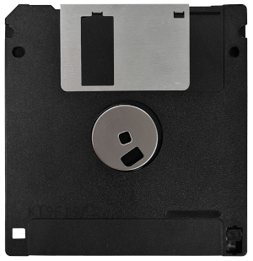
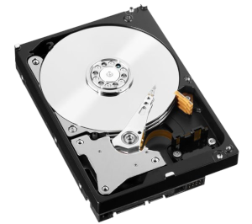
Random Access through Hard Drives
You could access data randomly
You had speeds of up to 5400 RPM which was later upgraded to 7200 RPM
But how to access the data efficiently?
1010101010001100110010000111000100001000100010100101010
1010101010001100110010000111000100001000100010100101010
1010101010001100110010000111000100001000100010100101010

Slide 6
History of SQL
Dr. E. F. Codd published the paper, "A Relational Model of Data for Large Shared Data Banks", in June 1970 in the Association of Computer Machinery (ACM) journal, Communications of the ACM. This model is now accepted as the definitive model for relational database management systems (RDBMS).
The language, Structured English Query Language (SEQUEL) was developed by IBM Corporation, Inc., to use Codd's model.
SEQUEL later became SQL (still pronounced "sequel") which is accepted as the standard RDBMS language even today.

Slide 7
Common Database Systems
Three major Database Management Systems in wide use
- Postgres – Open source, enterprise-scale, very tweakable
- Oracle - Large, commercial, enterprise-scale, very tweakable
- MySql - Simpler but very fast and scalable - commercial open source
- SqlServer - Very nice - from Microsoft (also Access)
Many other smaller projects, free and open source - HSQL, SQLite, ...

Slide 8
Single Table SQL
Single table SQL typically refers to operations or queries that involve working with only one table in a database
Learning these commands gives a very basic understanding of databases and how SQL works
Performing operations or queries on a single table involves various SQL commands and statements, such as:
SELECT
INSERT
UPDATE
DELETE
CREATE TABLE
UPDATE TABLE

Slide 9
Start Simple - A Single Table
$ sqlite3 zip.sqlite3
SQLite version 3.11.0 2016-02-15 17:29:24
Enter ".help" for usage hints.
sqlite> .tables
sqlite> CREATE TABLE Users(
...> id INTEGER NOT NULL
...> PRIMARY KEY AUTOINCREMENT,
...> name VARCHAR(128),
...> email VARCHAR(128)
...> ) ;
sqlite> .tables
Users
sqlite> .schema Users
CREATE TABLE Users(
id INTEGER NOT NULL
PRIMARY KEY AUTOINCREMENT,
name VARCHAR(128),
email VARCHAR(128)
);
sqlite>
CREATE TABLE Users(
id integer NOT NULL
PRIMARY KEY
AUTOINCREMENT,
name VARCHAR(128),
email VARCHAR(128)
);
https://www.dj4e.com/lectures/SQL-01-Basics.txt

Slide 10
SQL Important Commands
INSERT INTO Users (name, email) VALUES ('Kristin', 'kf@umich.edu')
DELETE FROM Users WHERE email='ted@umich.edu'
UPDATE Users SET name='Charles' WHERE email='csev@umich.edu'
SELECT * FROM Users
SELECT * FROM Users WHERE email='csev@umich.edu'
https://www.dj4e.com/lectures/SQL-01-Basics.txt

Slide 11
Database Model
A database model shows the logical structure of a database, including the relationships and constraints that determine how data can be stored and accessed.
Individual database models are designed based on the rules and concepts of whichever broader data model the designers adopt.
Most data models can be represented by an accompanying database diagram.
https://www.lucidchart.com/pages/database-diagram/database-models

Slide 12
Relational Model
The most common model, the relational model sorts data into tables, also known as relations, each of which consists of columns and rows.
Each column lists an attribute of the entity in question, such as price, zip code, or birth date.
A particular attribute or combination of attributes is chosen as a primary key that can be referred to in other tables, when it’s called a foreign key.
SQLite that we will use in Django App, works on the Relational Model
https://www.lucidchart.com/pages/database-diagram/database-models

Slide 13
Let’s make a Database in SQLite using Python Anywhere
Demonstration

Slide 14
Object Relational Mappers
Object-Relational Mapping (ORM) is a programming technique used to map objects from object-oriented programming languages to the tables in a relational databases.
Objects are used to store and retrieve data from databases.
Improves portability across various database dialects (SQLite, Postgres, MySQL, Oracle).
MySQL
Python
Model Library
Models.py
SQL
Postgres
SQLite

Slide 15
Defining a Table in Django
SQL:
CREATE TABLE Users(
name VARCHAR(128),
email VARCHAR(128)
);
models.py:
from django.db import models
class User(models.Model):
name = models.CharField(max_length=128)
email = models.CharField(max_length=128)
https://github.com/csev/dj4e-samples/tree/master/users

Slide 16
Making Migrations
In Django, the makemigrations command is used to create migration files based on changes made to the models in your Django application.
When you define models (Python classes that represent database tables) or make changes to existing models, Django’s migration system helps manage these changes in a structured manner.
This command just creates files and does not apply them to the database
The migrate command applies the changes to the actual database

Slide 17
Request-Response Cycle
Web Server
Port: 80
Request
Response
Browser
Page 1
Parse/ Render
Page 2
Click
Second page
First page

Slide 18
Model View Controller
The Django Application that we will develop will work with these 3 basic functions
Model – The persistent data that we store and manage in a database
View – The view of the application created by HTML, CSS, Javascript, etc for accessing and getting data
Controller – The decision making that happens through the code at the backend

Slide 19
Store Data
Retrieve
Data
Web Server
2
3
Handle
Input
Build
HTML
1
4
HTTP
Request
HTTP
Response
Browser
https://www.dj4e.com/lessons/dj4e_mvc

Slide 20

Browser
Linux
D
O
M
N
G
I
N X
WGSIConfig
settings.py
Django
Routing
Click
urls.py
views.py
Parse
Response
Views
Templates
forms.py
Javascript
Database
Shell
Models
models.py
/admin
admin.py
https://www.dj4e.com/lessons/dj4e_mvc

